Slide 1
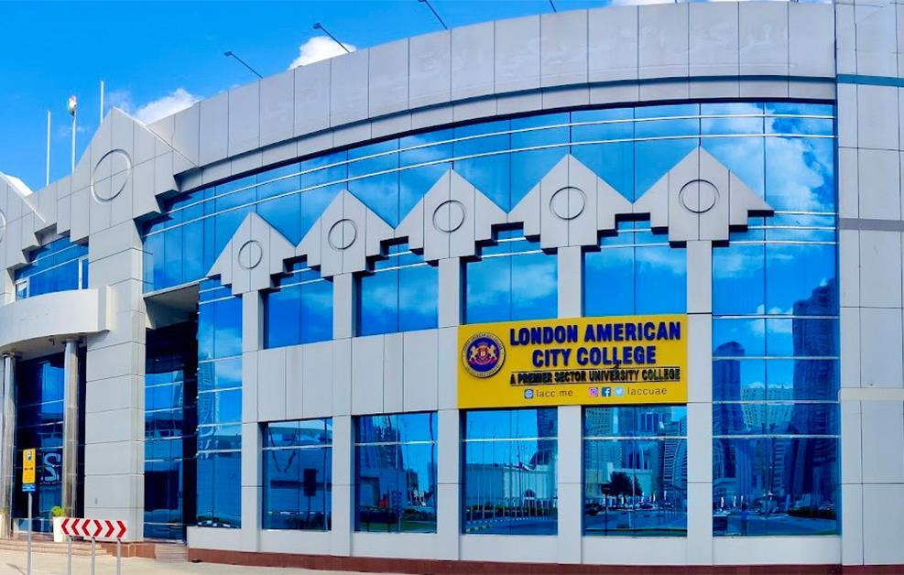
A PREMIER SECTOR UNIVERSITY COLLEGE
LONDON AMERICAN CITY COLLEGE
lacc.me

Slide 2
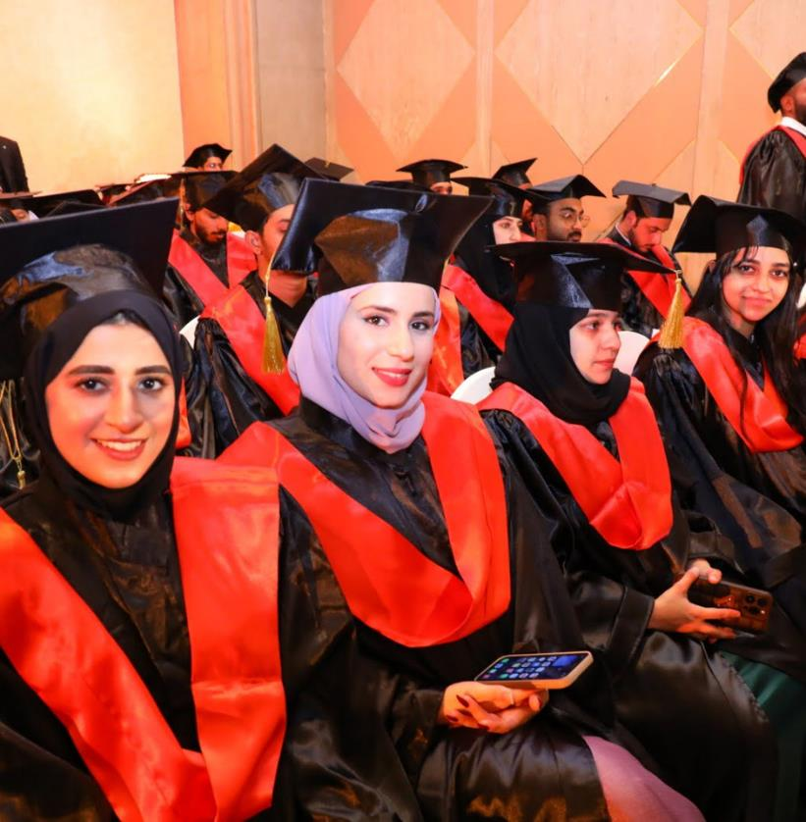
Table of Contents
Main Topics
Message for Students
President’s Message
Dean’s Message
Our Vision
Our Mission
LACC Accreditations
LACC’s Sister Institution and Affiliations
Course Offerings / Specializations / Semester
Extracurricular Activities
Alumni
Gallery
Open Admission
How To Apply
How to Get in Touch
LACC | Profile

Slide 3
MESSAGE FOR STUDENTS
EDUCATION IS THE PASSPORT TO THE FUTURE, FOR TOMORROW BELONGS TO THOSE WHO PREPARE FOR IT TODAY.
- Malcolm X
LACC | Profile

Slide 4
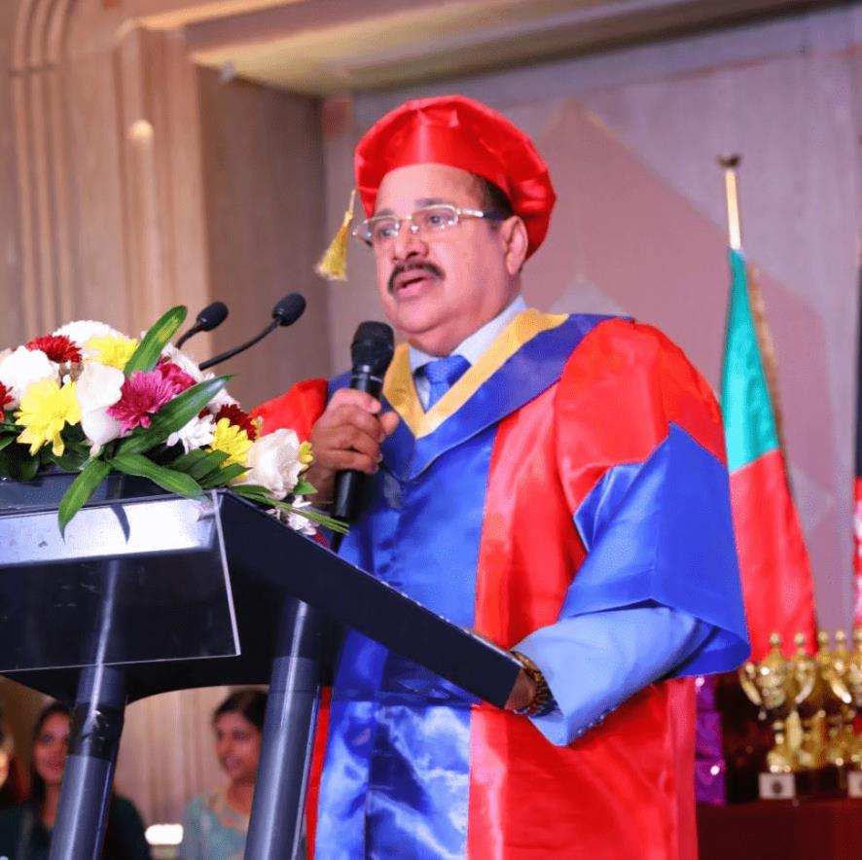
Welcome, Students!
President’s Message
Our college is the most popular and the most dynamic global educational institution of higher learning and is the number one college run by distinguished professors, which provides the most unique and the most innovative Advanced Diplomas, Post Graduate Diplomas, the Bachelor of Business Administration (BBA) and the Master of Business Administration (MBA) degree programmes in the UAE.
LACC | Profile

Slide 5
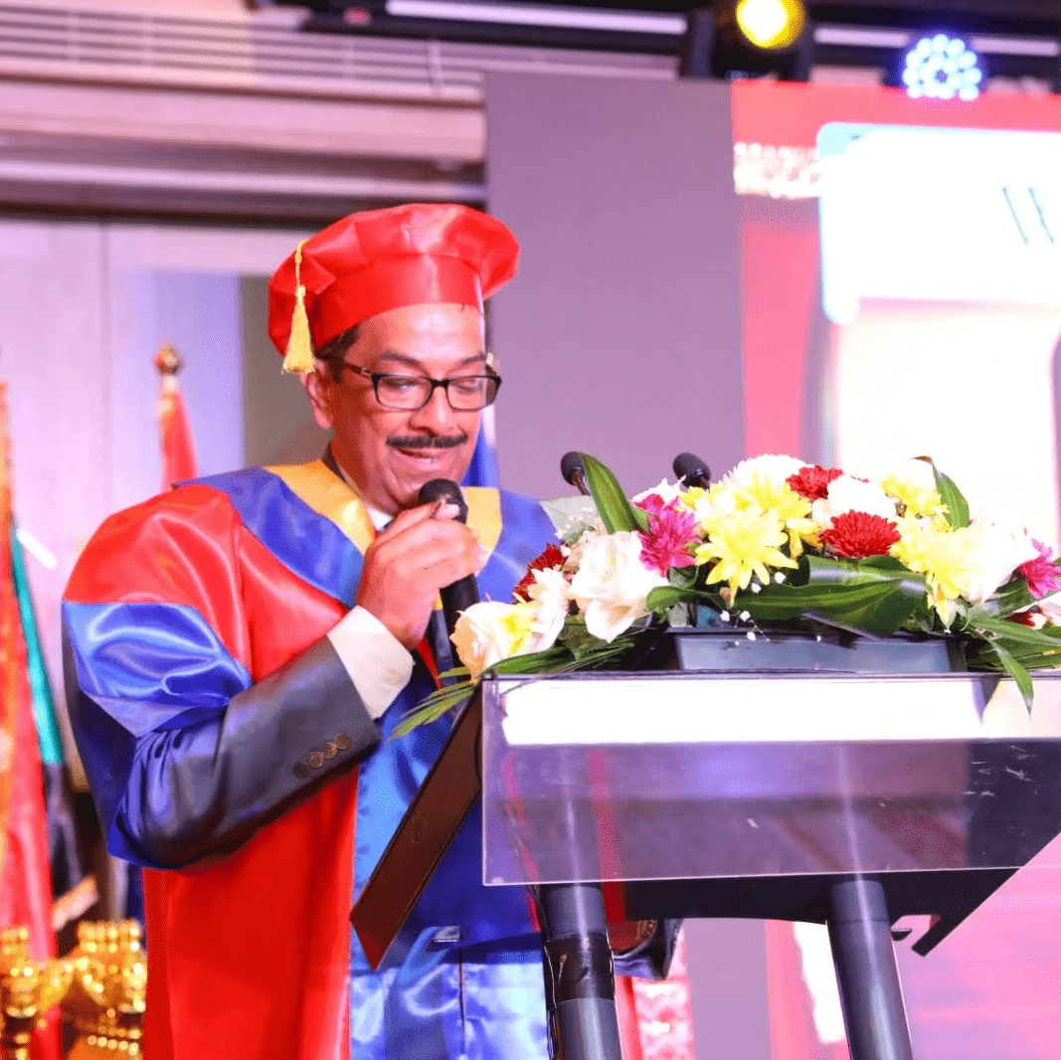
Dean’s Message
Dr. Kaup says, “Paradigm shift and change management strategies are essential components of a unique pedagogy in education. Planning a career means first acquiring the competencies relevant to the desired career path. No competency means, there is no career for the people.”
LACC | Profile

Slide 6
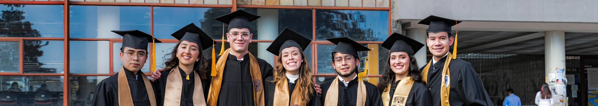
Our Vision
The Vision of the LACC is to become a world-class educational institution that transforms life, organizations, and society by providing affordable quality business education.
LACC | Profile

Slide 7

Our Mission
The Institutional Mission of the LACC is to foster a world-class business education that prepares students to become professionals in a dynamic global economy and promote academic excellence through engagement with communities and international institutions.
LACC | Profile

Slide 8

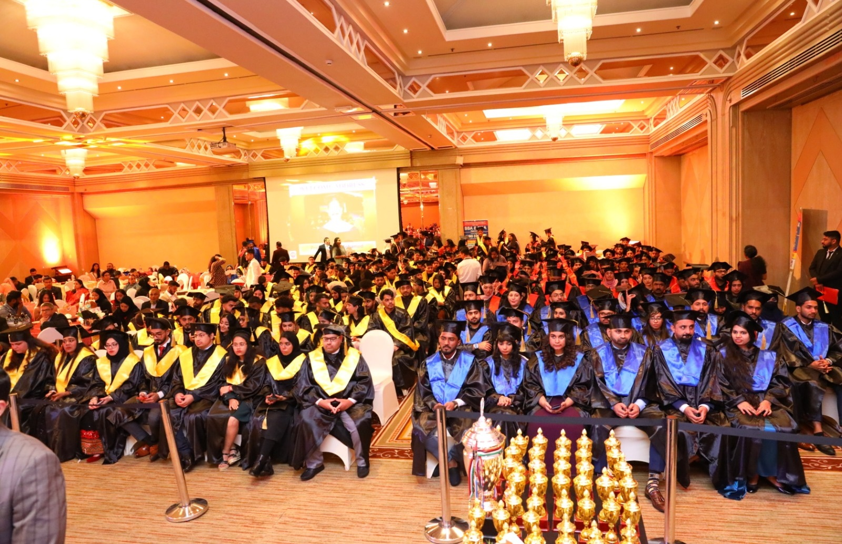
16,000+
SUCCESSFUL GRADUATES & POSTGRADUATES
London American City College has produced 16,000+ Successful Graduates and Post-Graduates with Global Leadership Qualities.
LACC | Profile

Slide 9






International Accreditation Council for Business Education (IACBE), Kansas, USA
European Council for Business Education (ECBE) Brussels ,Belgium
LACC ACCREDITATIONS
&
Educational
MEMBERSHIP
Accreditation Service for International Schools, Colleges & Universities (ASIC), UK
International Accreditation Organization Houston, USA
Educational member of the Accreditation Council for Business School and Programs (ACBSP), Kansas, USA
LACC | Profile

Slide 10

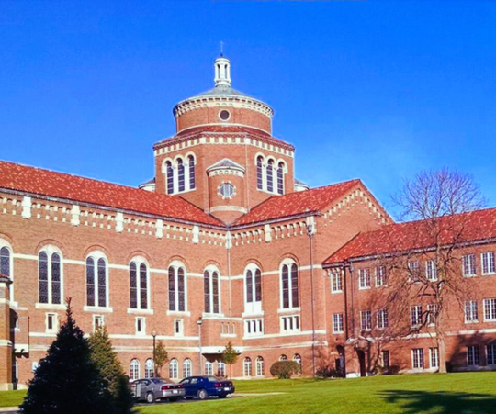
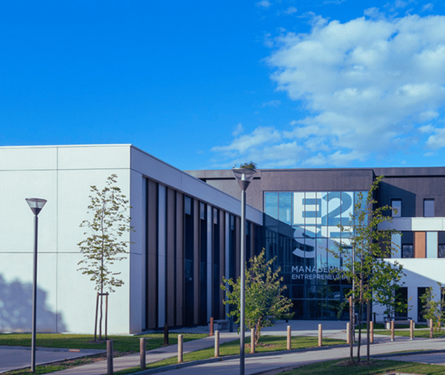
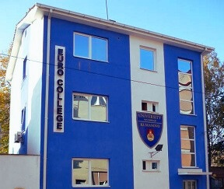
LACC’S SISTER INSTITUTION AND AFFILIATIONS
MADONNA UNIVERSITY
COLLEGE DE PARIS
EURO COLLEGE
LACC | Profile

Slide 11

Madonna University receives its institutional accreditation through the Higher Learning Commission (HLC). The HLC accredits degree-granting post-secondary educational institutions in the North Central region of the United States and thereby grants membership in the Commission.
Accreditation Council for Business Schools & Programs (ACBSP).
Council on Social Work Education
Forensic Sciences Education Programs Accreditation Commission (FEPAC)
Michigan Board of Education
National Council for Accreditation of Teacher Education
LACC | Profile

Slide 12

Collège de Paris programs prepare students for degrees registered in the Répertoire National des Certifications Professionnelles (RNCP).
Accredited and approved by the French Government.
LACC | Profile

Slide 13

Euro College is accredited by the Board of Accreditation of the Ministry of Education of the Republic of Macedonia and permanent license from the Ministry of Education to deliver courses in BBA and MBA degree programs.
Euro College is also accredited by IDEAL (International Distance Education Accreditation League) – a renowned international accrediting agency consisting of academic professionals from Asia, the USA, and Europe.
Euro College is also accredited by EDU. EDU is an Intergovernmental Organization formed by International Treaty to promote quality education and accreditation.
LACC | Profile

Slide 14

LAUC - LACC'S SISTER UNIVERSITY
London American City College’s Sister University “LONDON AMERICAN UNIVERSITY COLLEGE” in LUSAKA is Accredited by the Higher Education Authority (HEA) of the Ministry of Education of the Republic of Zambia.

Slide 15
BBA/BS PROGRAMMES
BS(Hons) in International Business & Economics
Bachelor of Science in Business Information Systems.
BBA in International Business
BBA in Marketing
BBA in Accounting
BBA in Finance
BBA in Fashion Management
BBA in Human Resource Management
BBA in Information Technology
BBA in Travel and Tourism Management
LACC | Profile

Slide 16
MBA PROGRAMMES (COLLEGE-DE PARIS)
MBA in International Business
MBA in Accounting
MBA in Marketing
MBA in Finance
MBA in Supply Chain & Logistics Management
MBA in Travel & Tourism Management
MBA in IT Management & Security
MBA in Human Resource Management
MBA in Quality & Operations Management
MBA in Project Management
LACC | Profile

Slide 17
MBA in Hospitality Management
MBA in Sports Management
MBA in Fashion Management
MBA in Luxury Brand Management
MBA in Insurance Management
MBA in Real Estate Management
MBA in Banking and Investment
LACC | Profile

Slide 18
MBA PROGRAMMES (MADONNA UNIVERSITY)
MBA - General
MBA in Quality Management
MBA in Operations and Global Supply Chain Management
MBA in Non-Profit Leadership Programme
LACC | Profile

Slide 19
THREE SEMESTERS IN A YEAR
SEM 1: JAN – MAY
SEM 2: JUNE -JULY
SEM 3: SEPT - DEC
VACATION: AUGUST
LACC | Profile

Slide 20
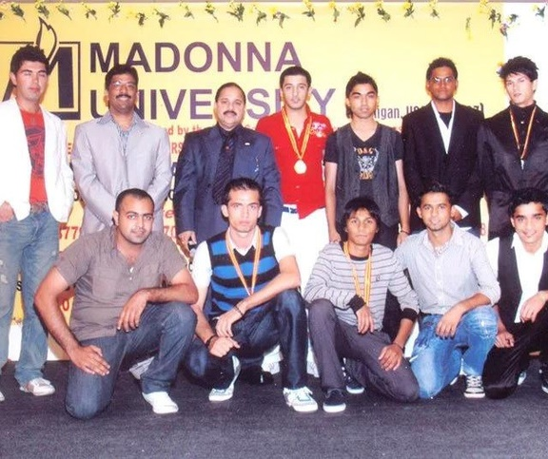
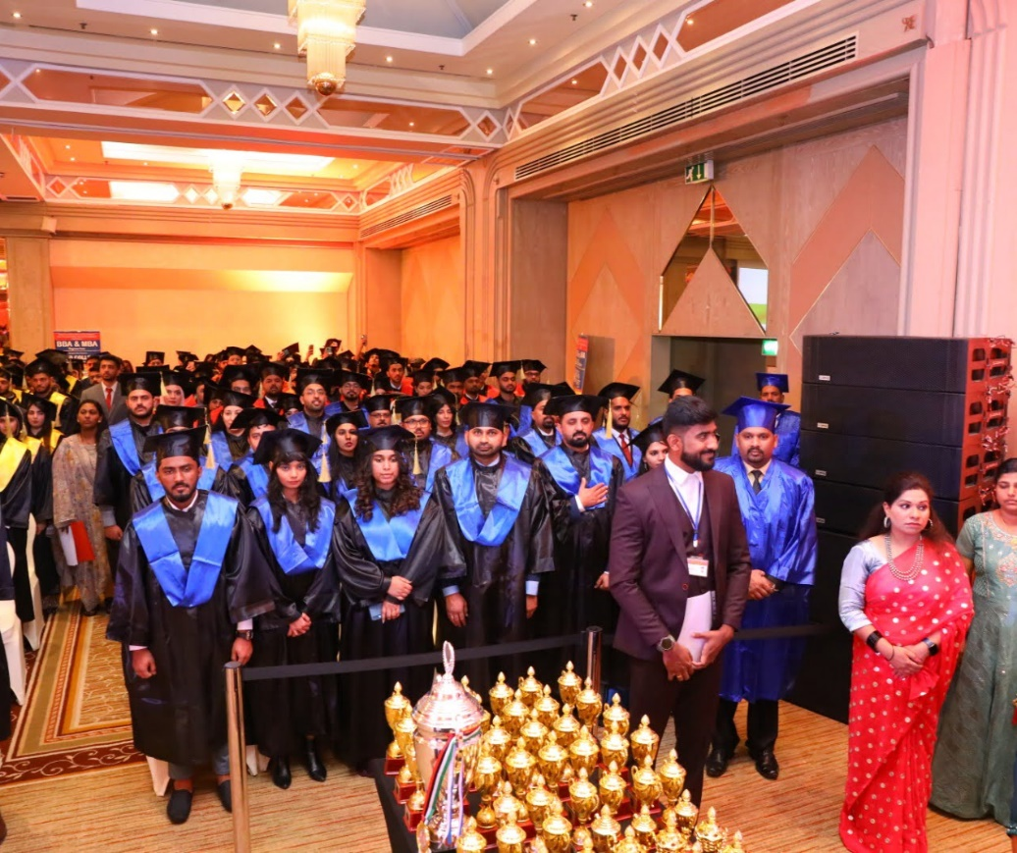
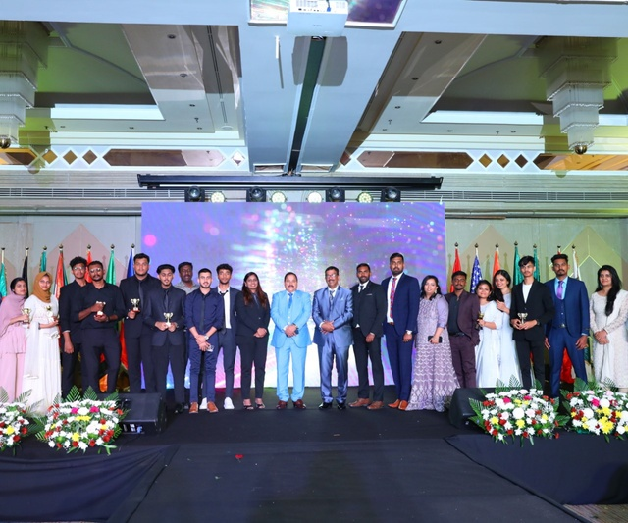
EXTRACURRICULAR
ACTIVITIES
Students can take part in many extracurricular
activities outside of academic obligations.
Sports Day
Graduation Ceremony
Fresher’s & Farewell Party
LACC | Profile

Slide 21
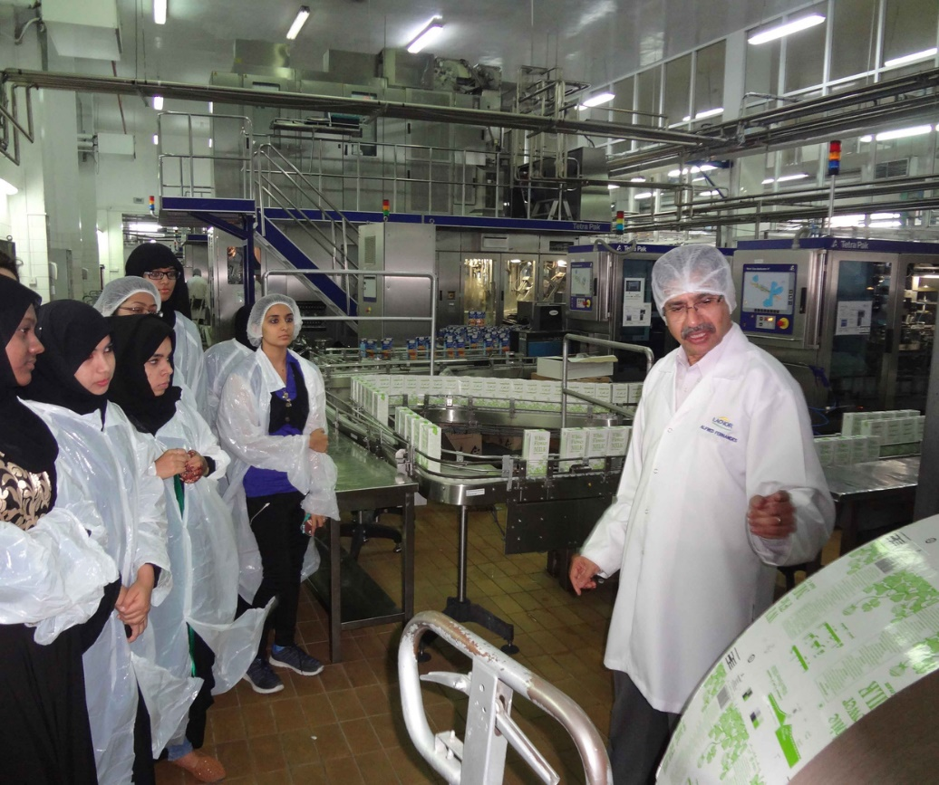
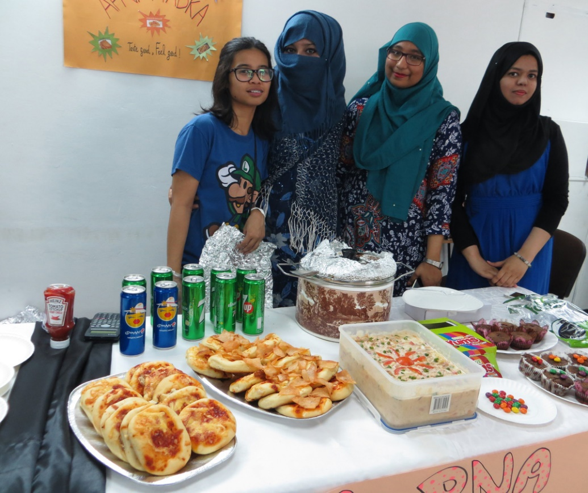
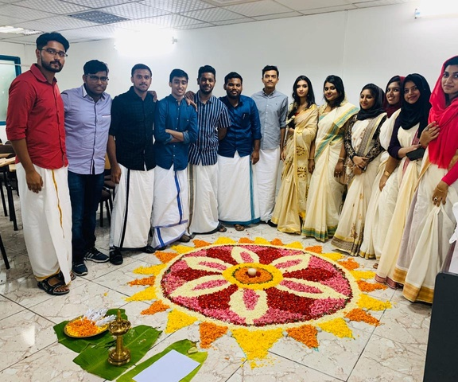
Students can take part in many extracurricular
activities outside of academic obligations.
Technical/Industrial Visits
Food Festival
Ethnic Day celebrations
LACC | Profile

Slide 22

ALUMNI TALK
MALA ISHWAR BHATIA, HR MANAGER, WALMART, TORONTO, CANADA
MARIAM ANDREA HASSAN, PA CEO & CHAIRMAN, CLEMENT SYSTEMS, GULF FZCO
I was a stone when I joined the LACC, and now I have become a diamond through the abundant knowledge which I have gained from my distinguished professors, who have been instrumental in my great career success.
I could tremendously enhance my knowledge and skills by studying the programs of LACC. LACC’s professors are brilliant, highly knowledgeable, and very helpful and the learning environment on the LACC campus is truly international.
MISS REHANA ABDULLAH, TEACHER IN (BRITISH CURRICULUM SCHOOL), U.A.E
MUHAMMAD NAEEM IQBAL, PAKISTAN
Dreams become reality when the intentions are stronger and actionable” is what motivated and inspired my years of study at the prestigious College in the U.A.E. I owe to this institution for imparting motivation, strength, patience, and passion to succeed. This culture has flowed down from Dr. Prof Paulson Chunkapura, the President & CEO, and Dr. Prof. Kaup Mohammed Dean & Managing Director to every teaching faculty of the college. I wish the institution every success in its mission to provide us with the best quality qualifications from highly accredited foreign universities.
I feel I have achieved more than academics but also the experience and confidence to start my career. I would like to extend my gratitude to my Professors and Faculty members whose experience and never-ending support helped me to be one of the top students. I also would like to appreciate all the College staff whose hard work made the environment a peaceful environment to work and study. I would definitely recommend it to all future students.

Slide 23
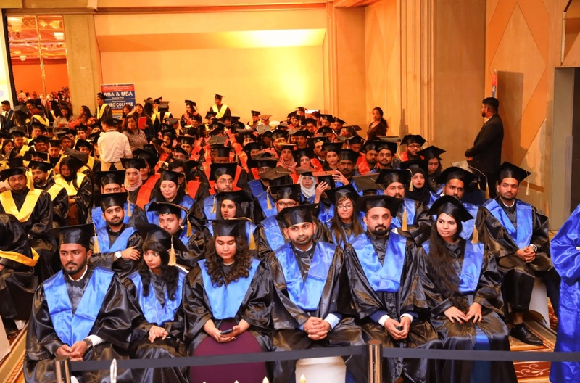
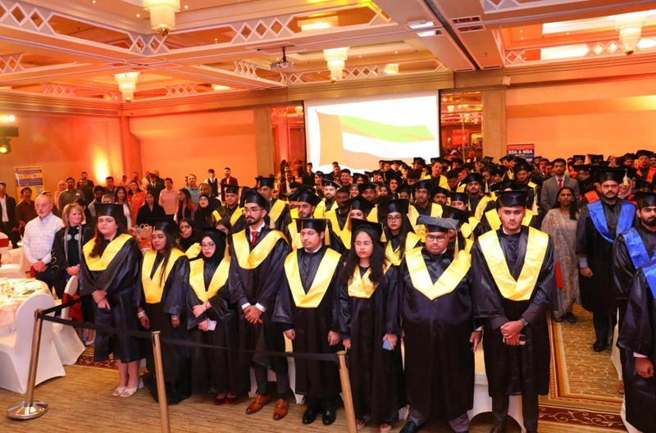
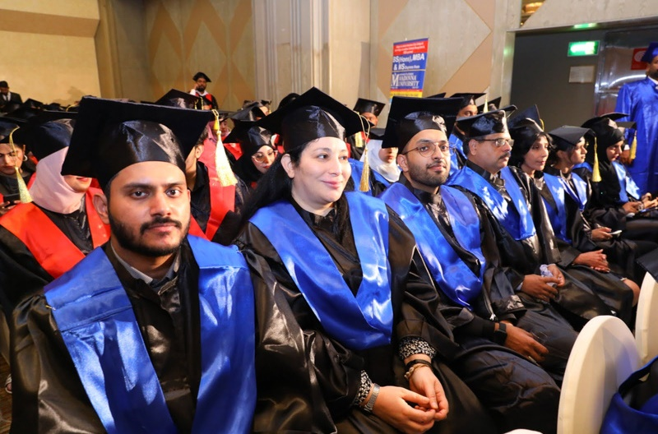
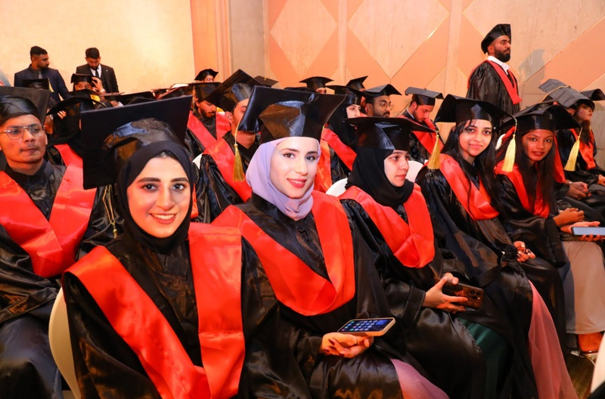
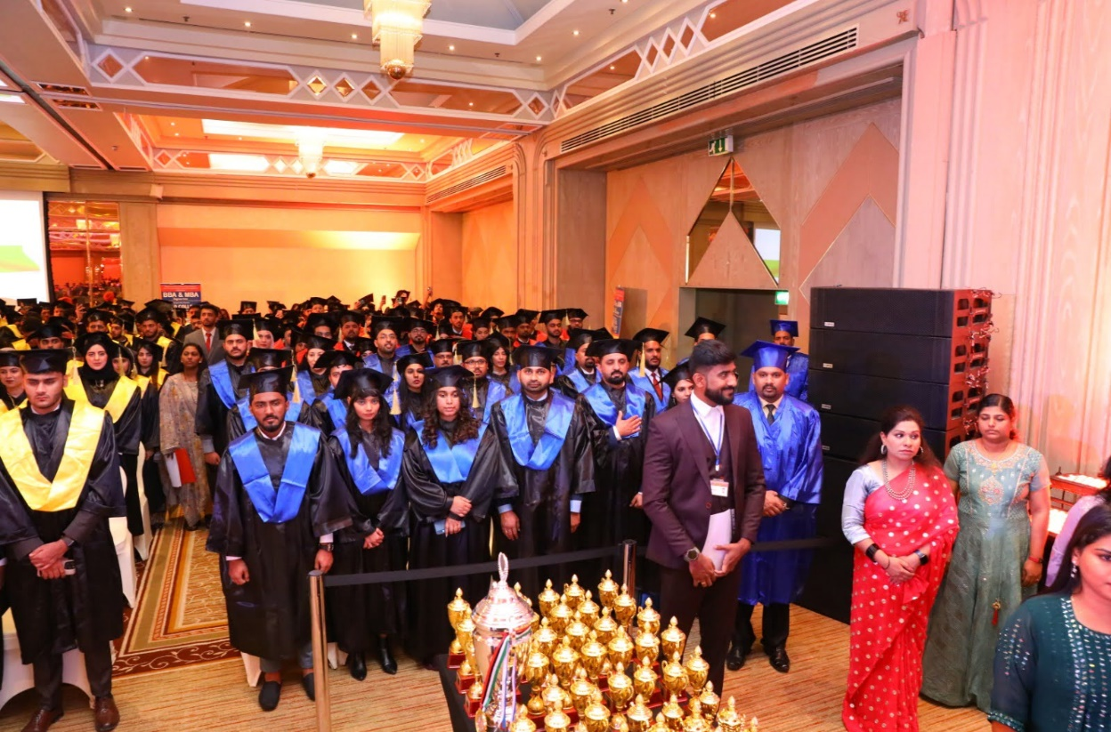
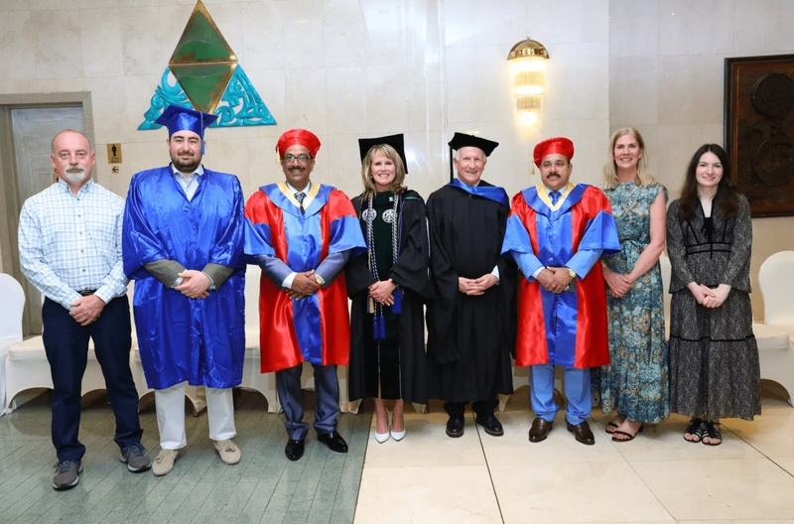
LACC | Profile
GALLERY
A closer look to our
university views.

Slide 24
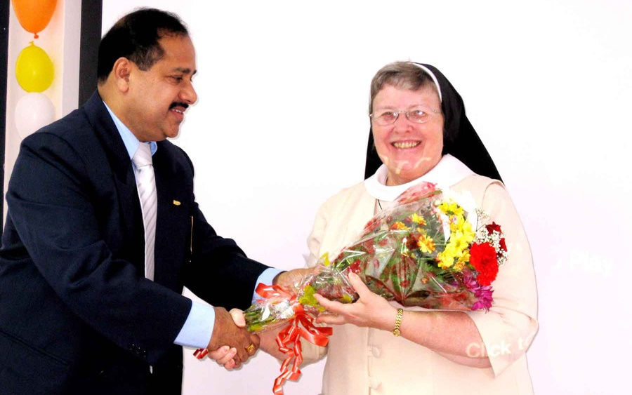

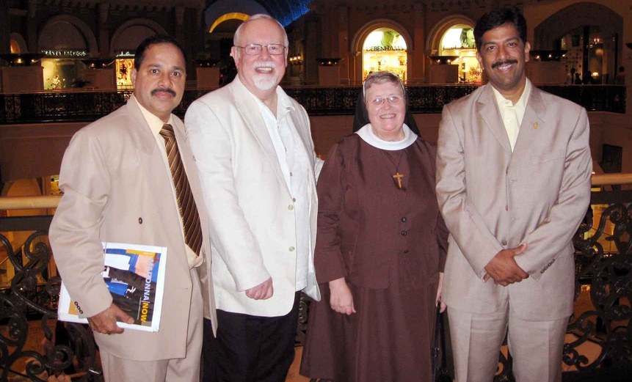
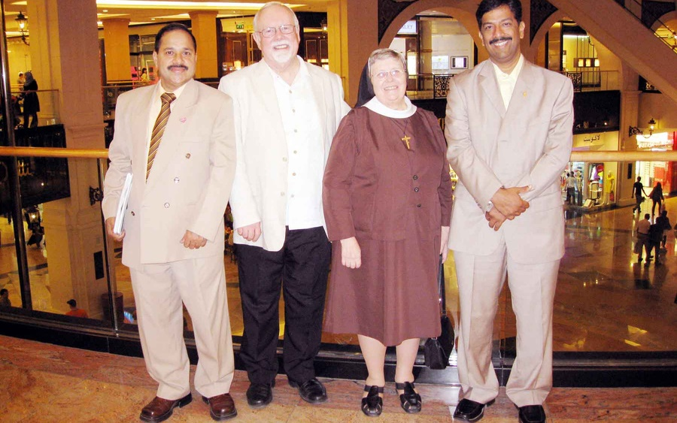
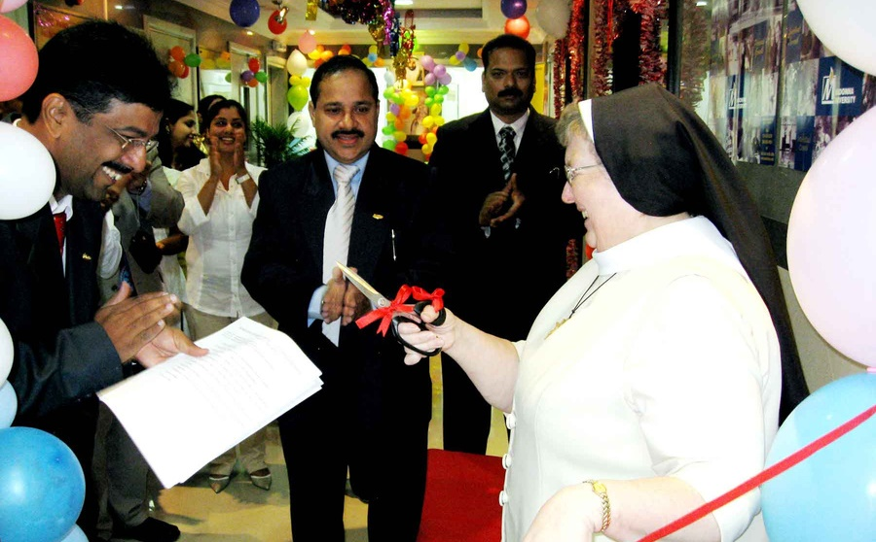
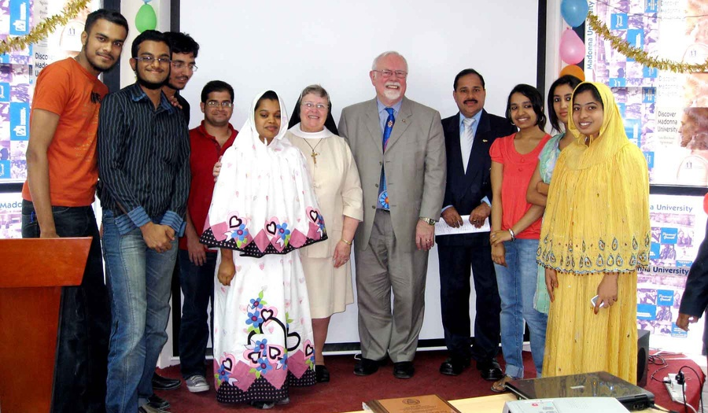
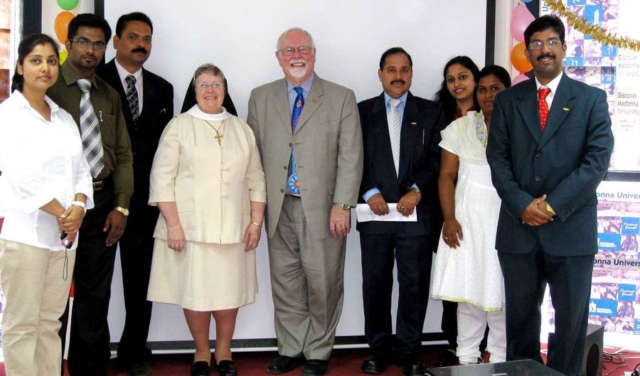
LACC | Profile
MADONNA UNI﻿VERSITY PRESIDENT'S VISIT

Slide 25
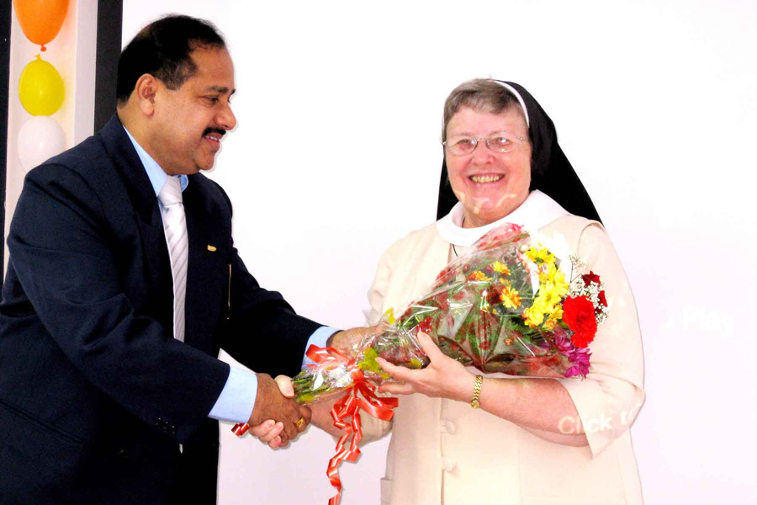
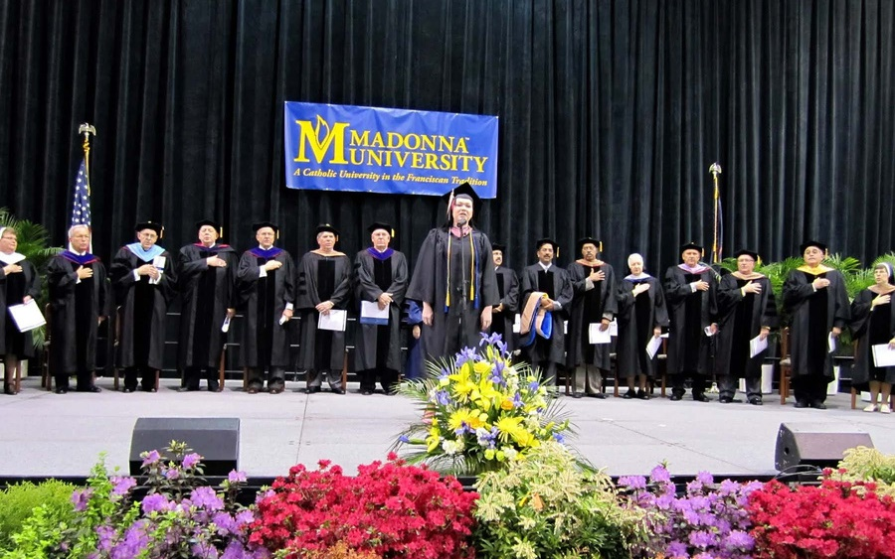
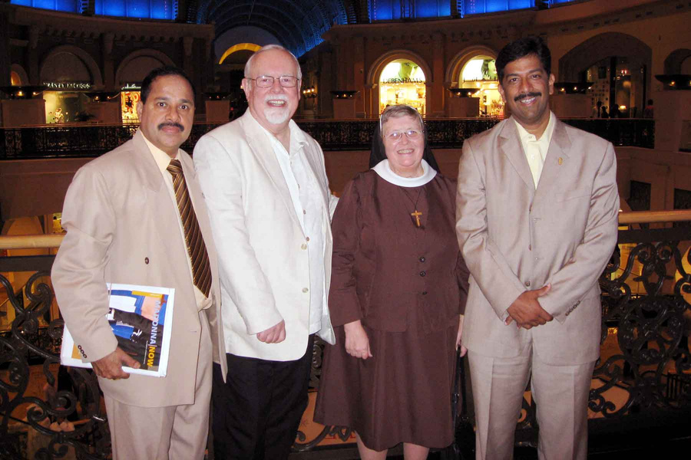
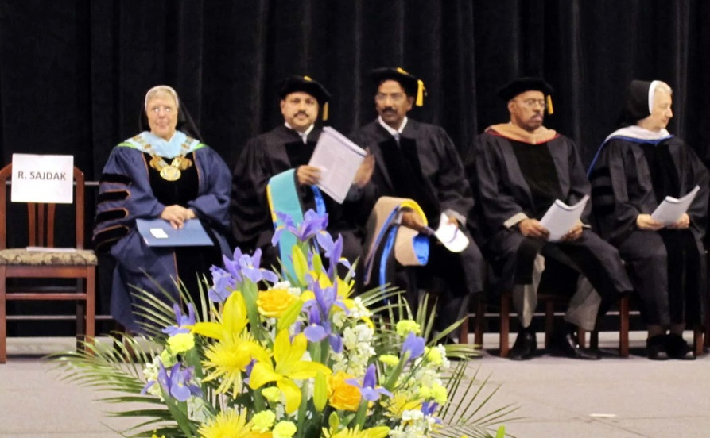
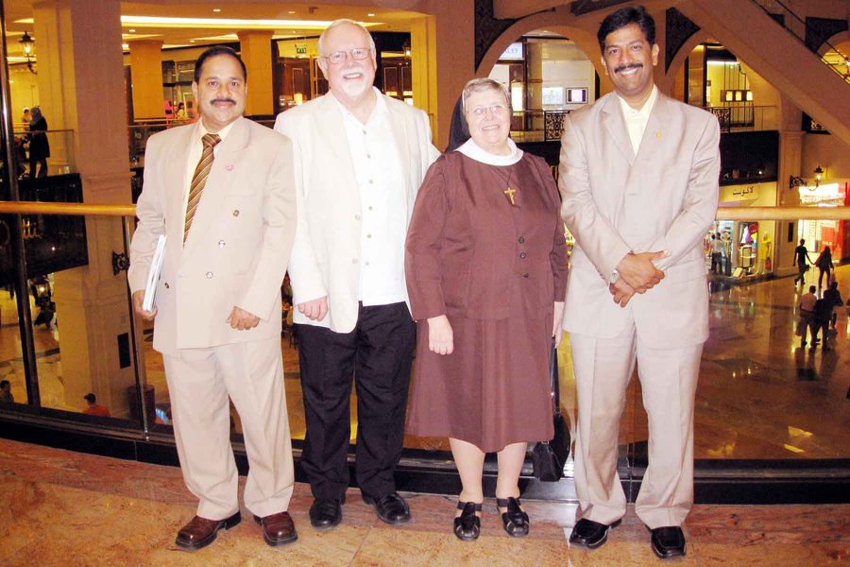
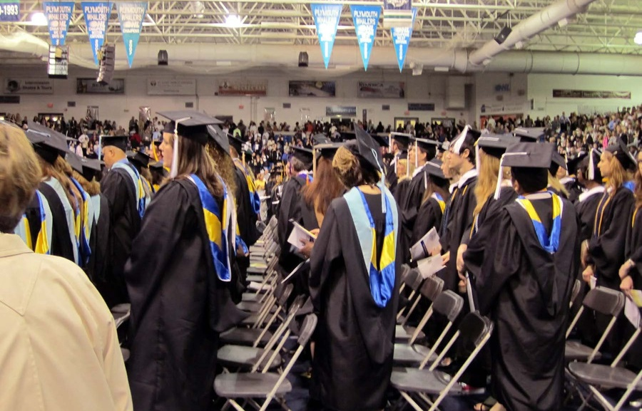
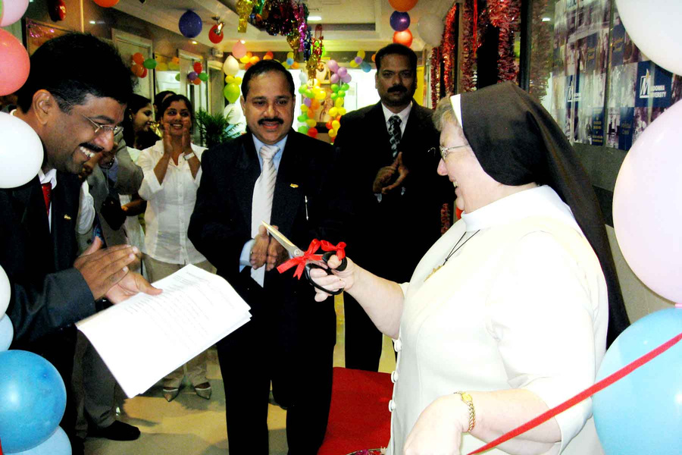
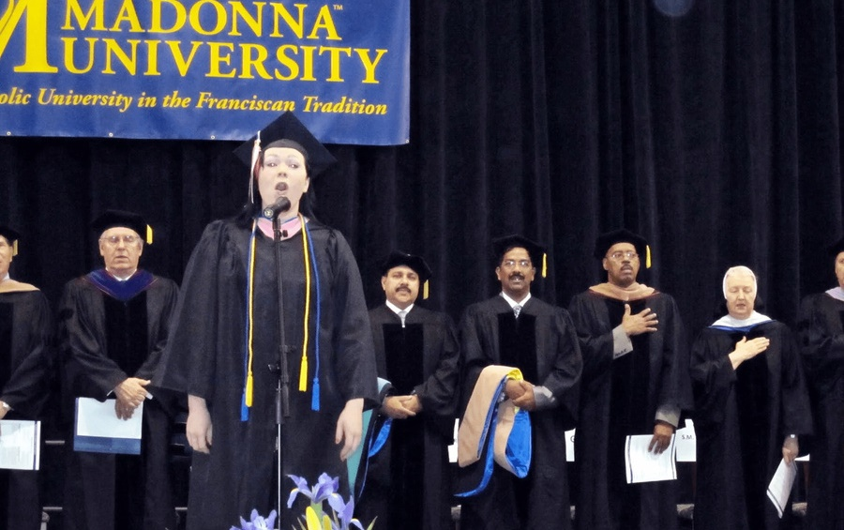
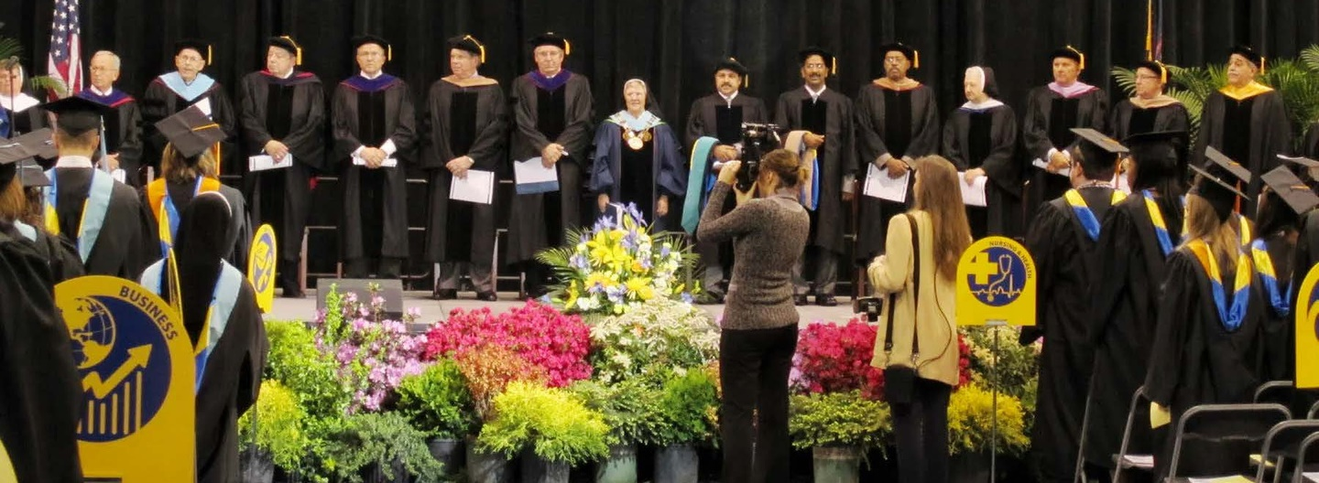
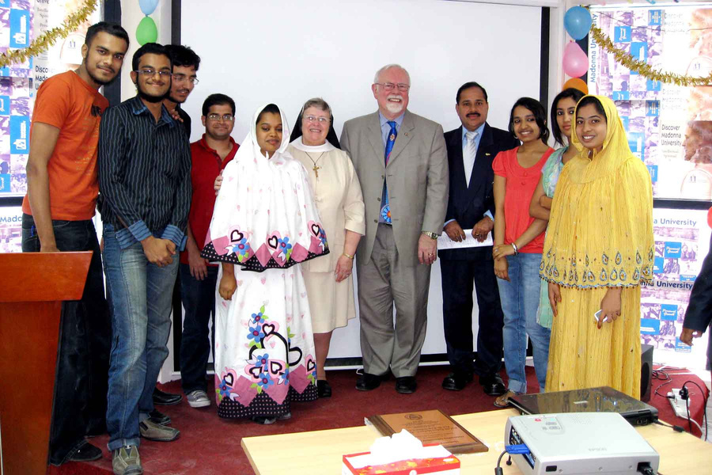
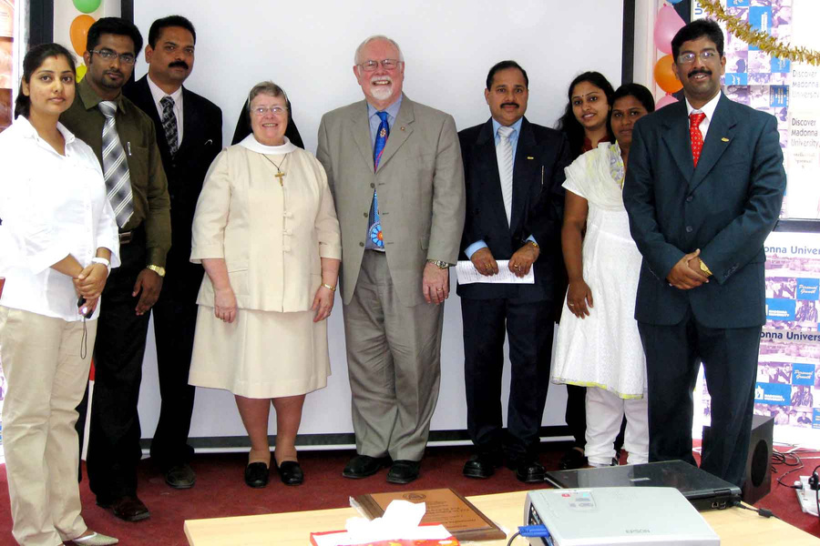
LACC | Profile
MADONNA UNIVERSITY GRADUDATION

Slide 26
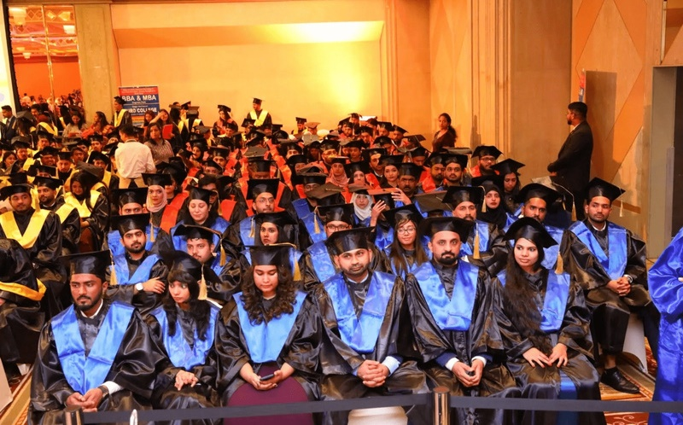
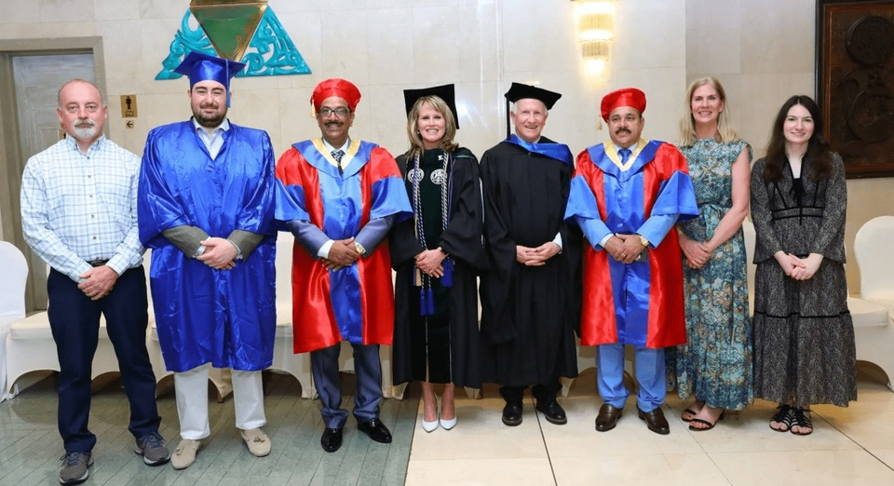
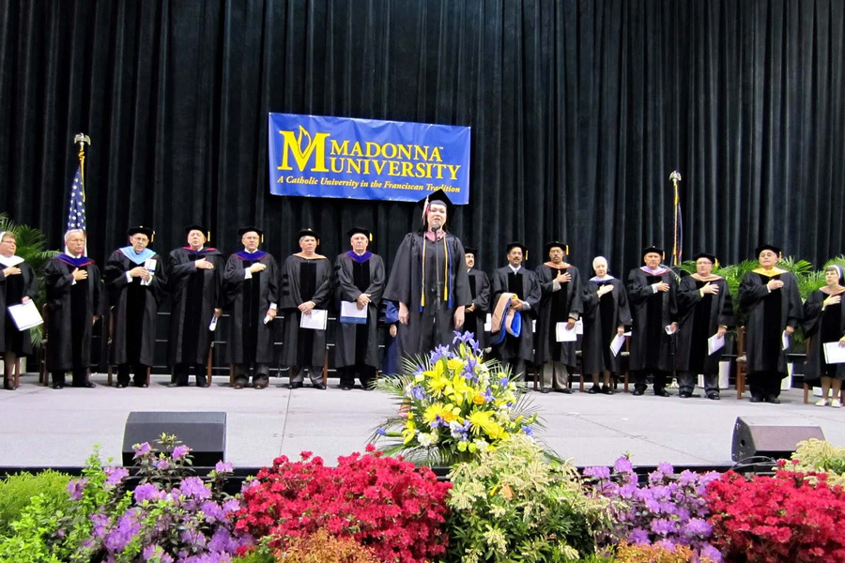
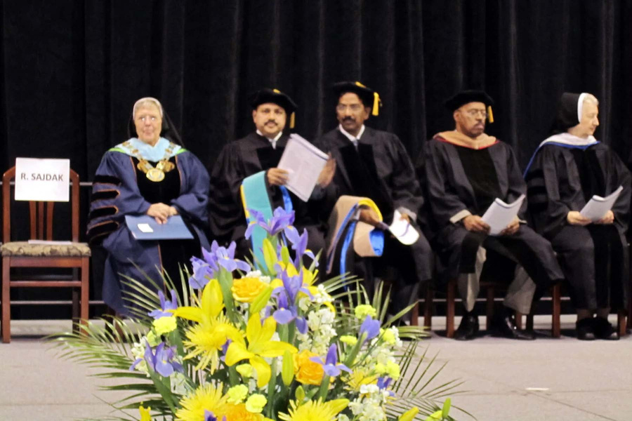
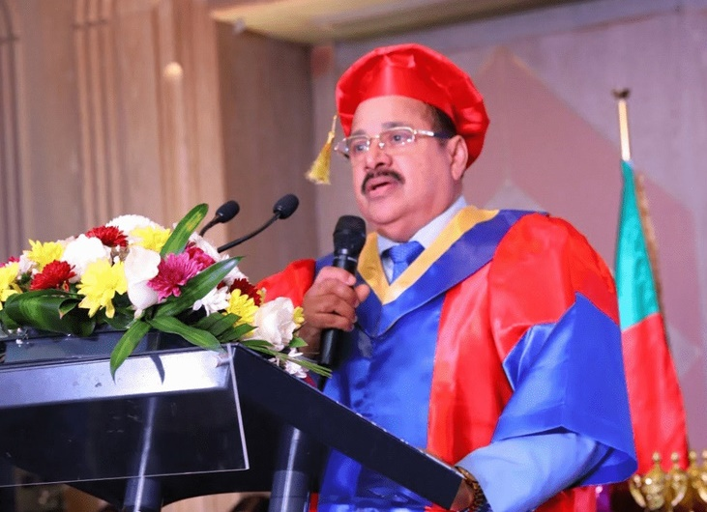
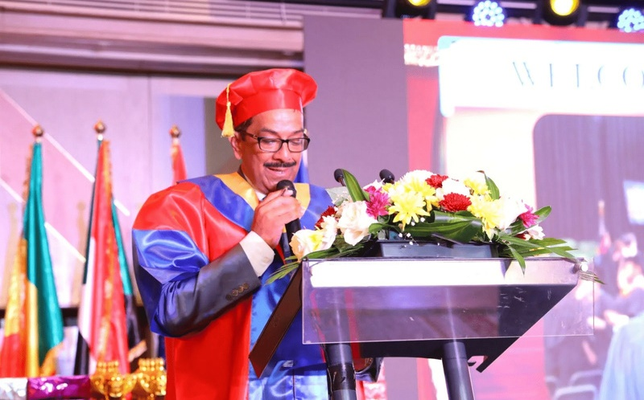
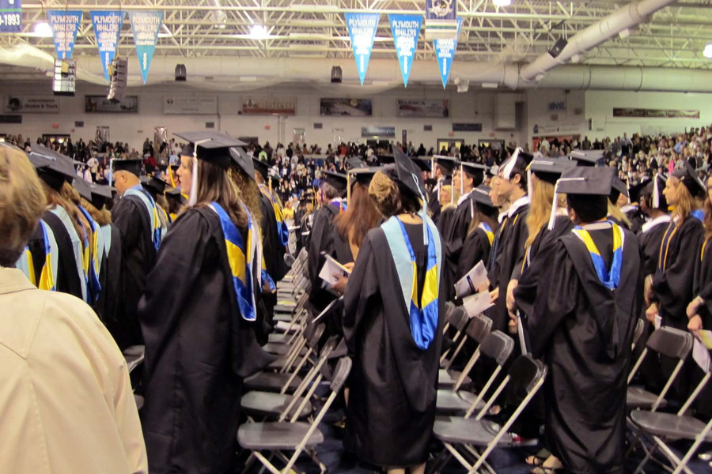
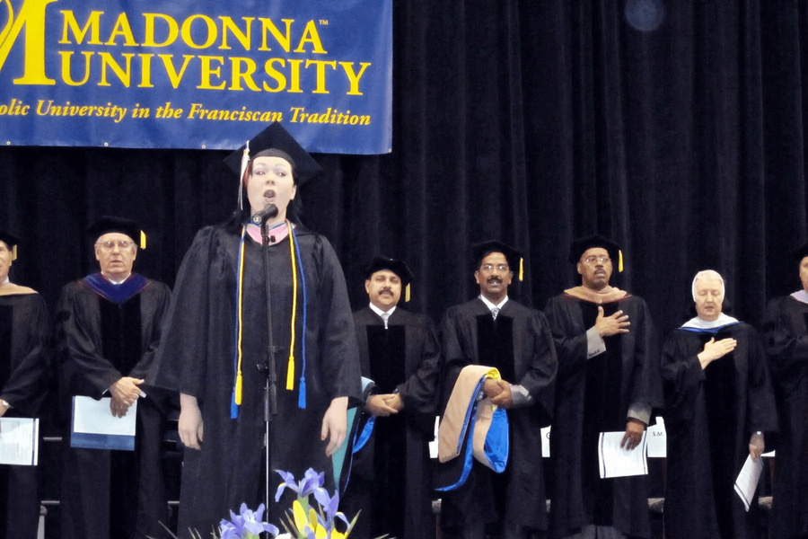
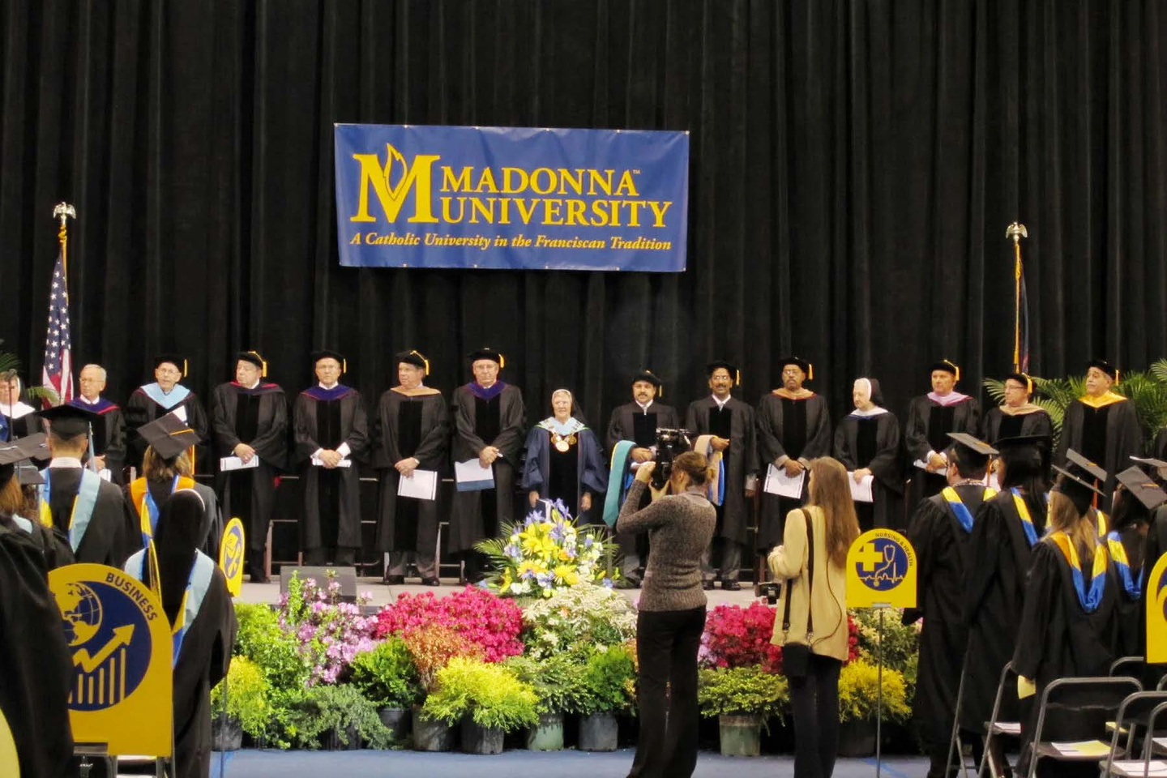
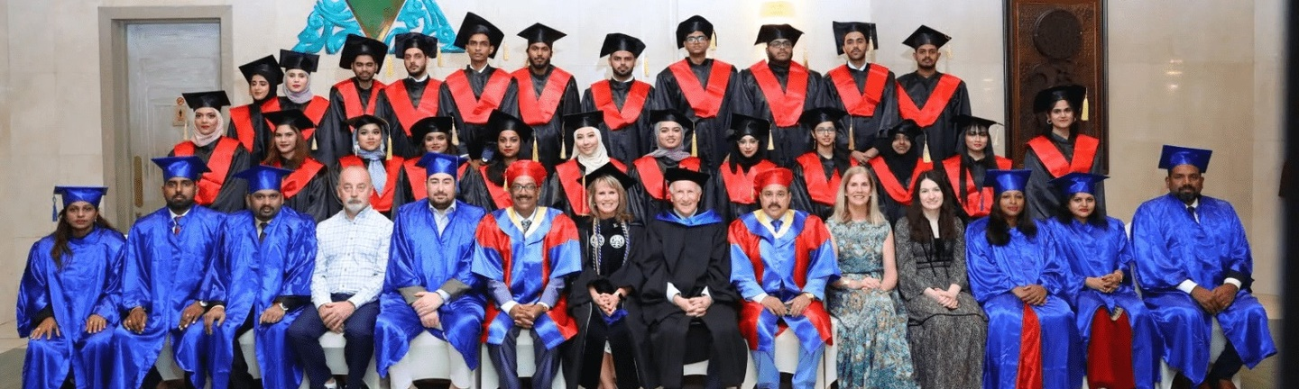
LACC | Profile
GRADUATION CEREMONY

Slide 27



ADMISSION
OPEN
Get ready to send your personal information and college admission queries to our college.
Admission Date
June - September 2023
Online Admission
lacc.ae | lacc.me | londonamerican.university
LACC | Profile

Slide 28


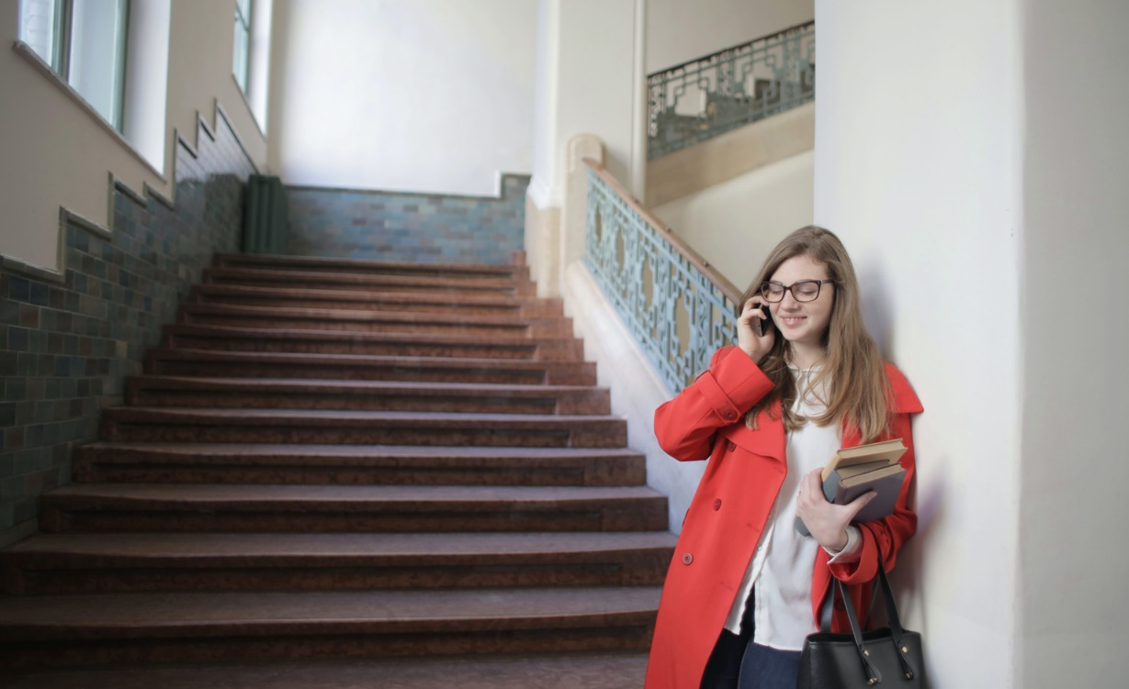
HOW TO APPLY
Select your course
Register online through website
Direct Communication
We provide Diplomas in Business Administration, BBA, BS in Business Information Systems, and MBA with lots of specialization options.
You can directly call our advisors from the contacts details in websites or you can directly call our toll free number: 800 5222
You can register online through our websites lacc.ae and lacc.me.
LACC | Profile

Slide 29

THE LACC APPLY ONLINE
A more convenient registration process
You can directly apply online through our websites lacc.ae as well as lacc.me.
Once you submitted the details an advisor would contact you soon.
LACC | Profile

Slide 30




HOW TO GET IN TOUCH
Telephone
052 7910854
Email
info@lacc.me
Main Office
87556 - Suite 39, Unique World Business Center, Hamsah A Building Ansar Gallery Complex - Al Karama - Dubai
LACC | Profile

